Slide 1

Applying Iterative Design Principles to a Live Product
Name: Xabier Laibarra
Date: 01/11/2023

Slide 2
Step 1
Select KPIs
&
Evaluate Previous Multivariate Experiment Results

Slide 3
Select KPIs for Flyber Analyses
For the data available, which KPI(s) best match Flyber’s business model?
1) I would measure the conversion between each step of the event process in the app:
a) From “open” to “amount_of_users”.
b) From “amount of users” to “search”.
c) From “search to “begin_ride”.
Amount of distinct session_id in the previous step divided by the amount of distinct session_id in the current stage (event_type) multiplied by 100 (so we get a percentage). After a more detailed analysis can be done, filtering by age, neighbourhood or other category.
How would you calculate these KPI(s) using the available event data logs?
Example: Amount of distinct session_id in the “search” event divided by the distinct amount of session_id in the “begin_ride” event type and then multiplying it by 100.
Distinct(session_id (event=begin_ride))*100/Distinct(session_id (event=search))
List other KPIs that might be important to Flyber but are not calculable based on available data
- Price by ride.
- Amount of passengers by ride.
- Customer satisfaction grade.
- Average ride duration.
- Idle time between rides for each plane.

Slide 4
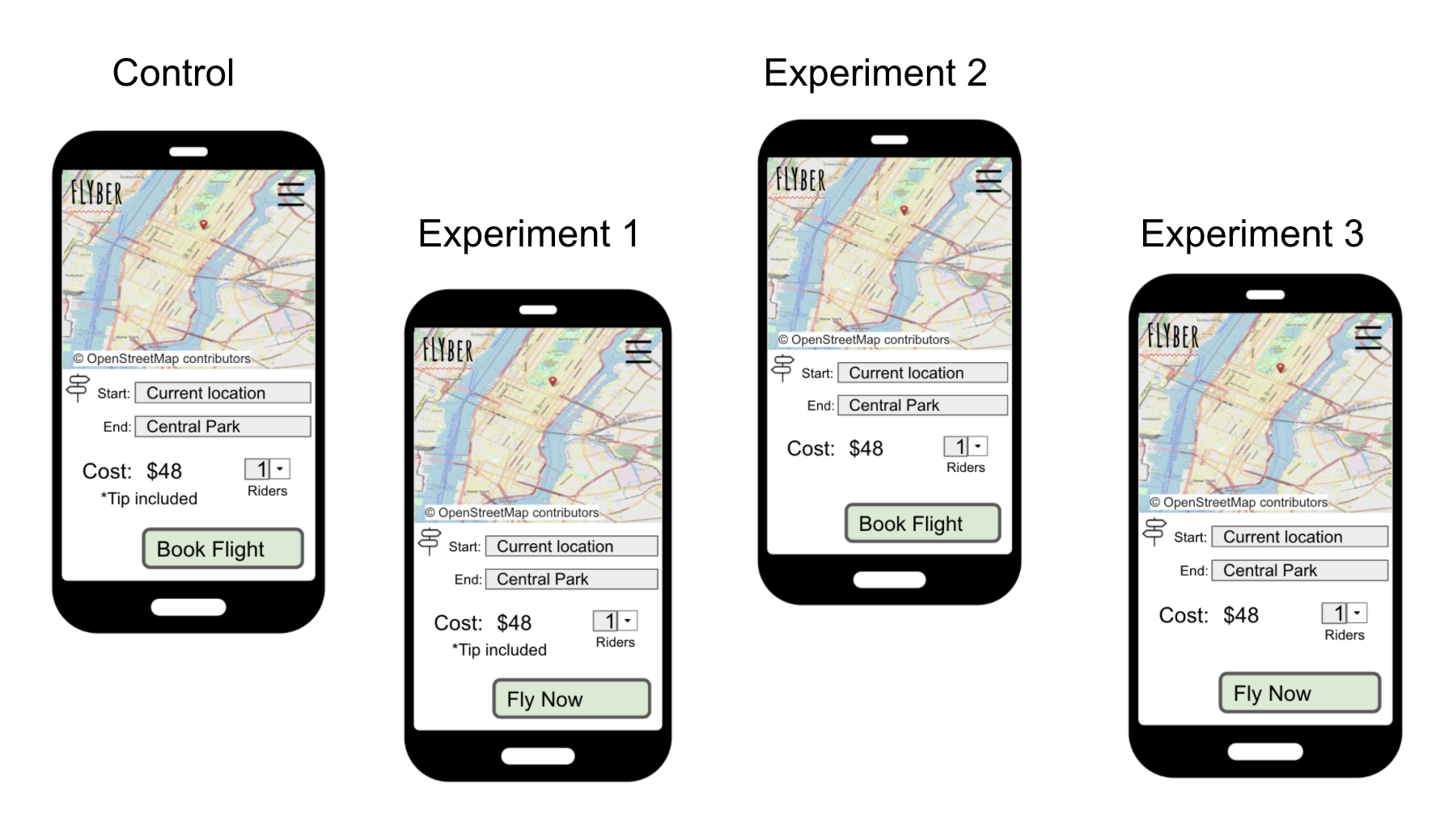
Describe the First Multivariate Experiment
In this multivariate experiment, the control group was compared to other three experiment groups.
Here, we are going to compare the conversion rate variation when making a modification compared to the control group.
At the end, we are going to perform a t-test in order to prove wether the results are significant or not.

Slide 5
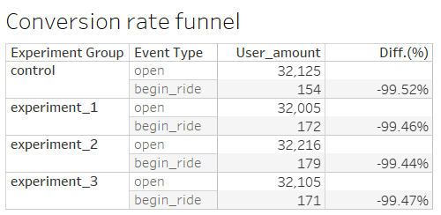
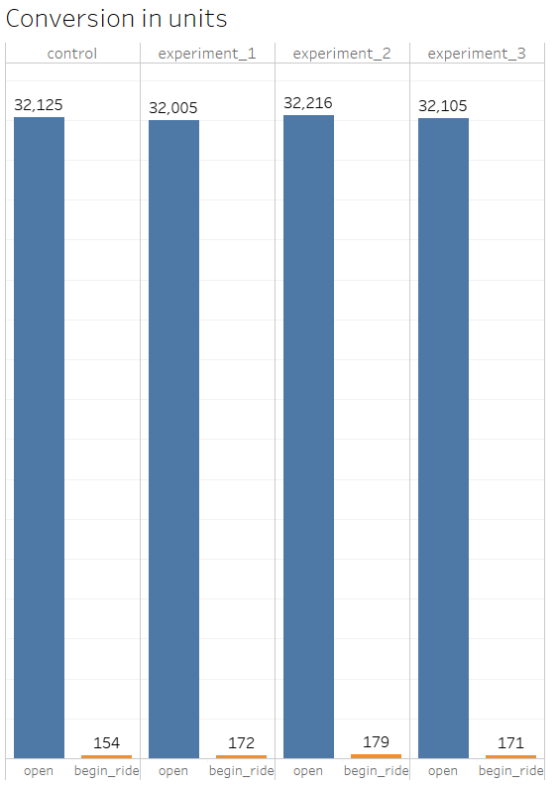
Review Multivariate Test Results: Visualization
As we can see in the table funnel in and in the bar chart below, all the three experiments have higher conversion rates than the control group, when booking a flight.

Slide 6
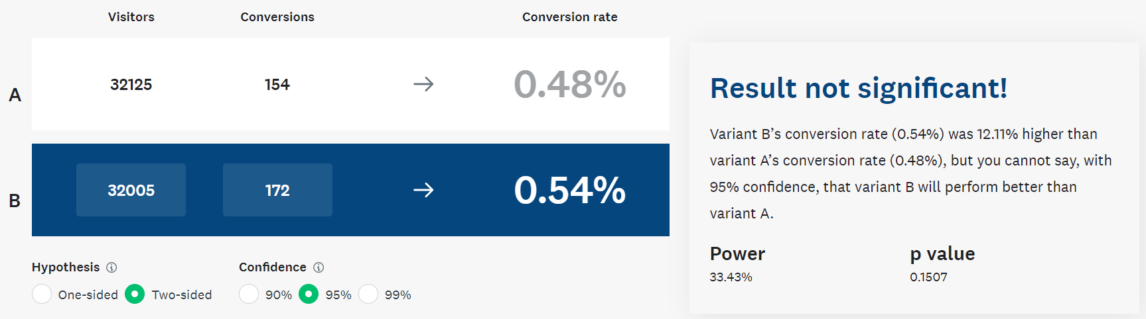
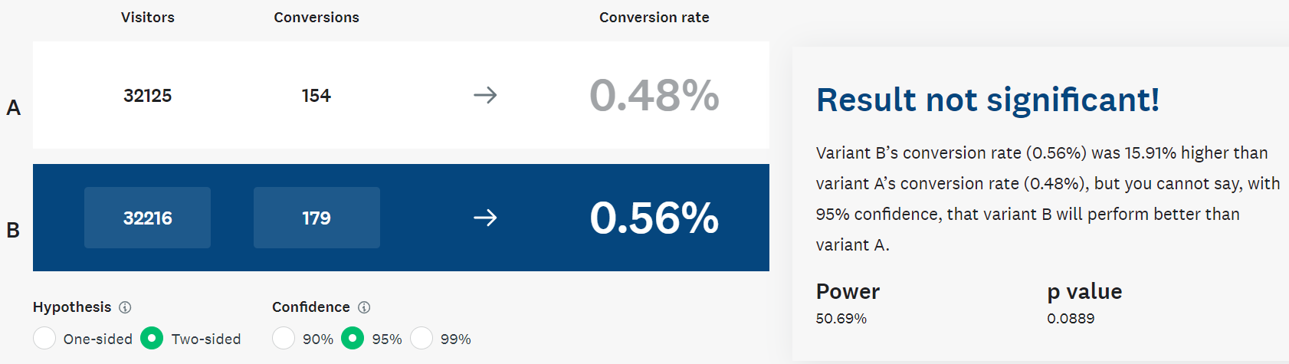
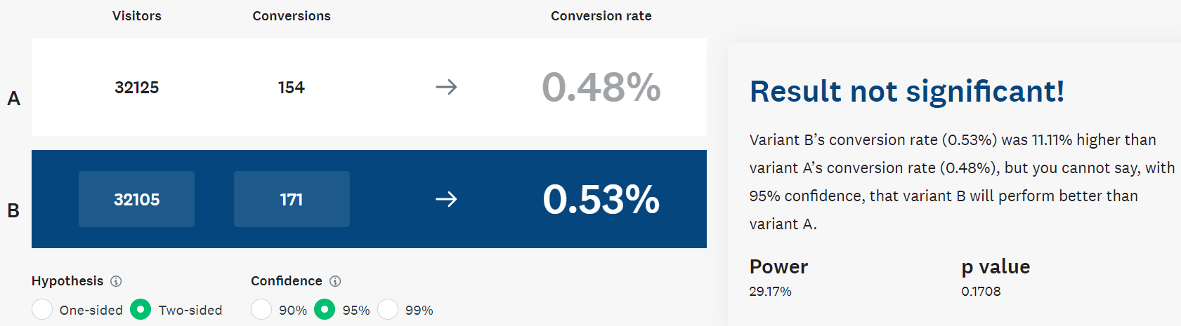
Review Multivariate Test Results: Significance Test
Below we compare the control group against the first experiment group, the second experiment group and the third experiment group (ordered from top to bottom). In the screenshots it is possible to see the conversion rate for each group ant the p-value for two sided hypothesis with confidence interval of the 95%. As we can see, none of the experiments bring significant improvements compared to the control group, so we would not implement any change.
Control group vs experiment group 1
Control group vs experiment group 2
Control group vs experiment group 3

Slide 7
Step 2
Funnel & Cohort Analyses

Slide 8
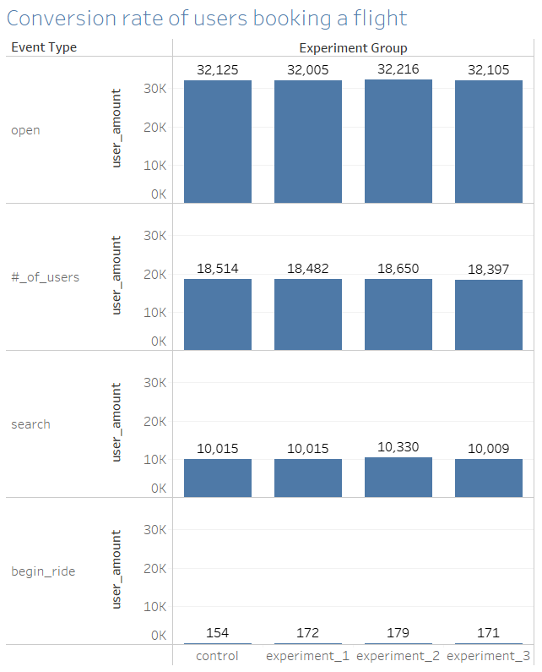
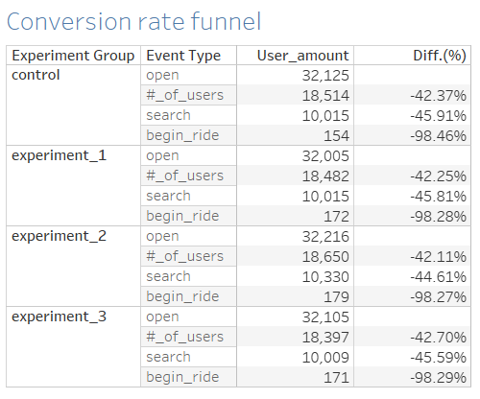
User Funnel
Identifying the different stages the user funnel
Based on the event types in the available data, we are going to analyze the 3 steps that a user can take from opening the app to the final booking of a ride.
Below, a graph and a table showing the funnel from event type to event type step by step:

Slide 9
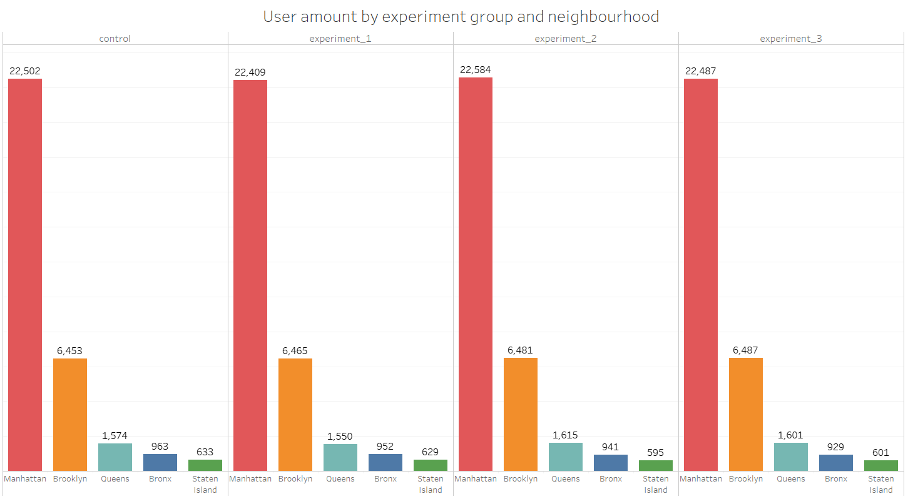
User Segments
In the available data we can identify age and neighbourhood as the two main demographic attributes that allow for segment analysis.
Neighbourhood
The segment group with the largest amount of users is the neighbourhood of Manhattan (see bar plot below).

Slide 10
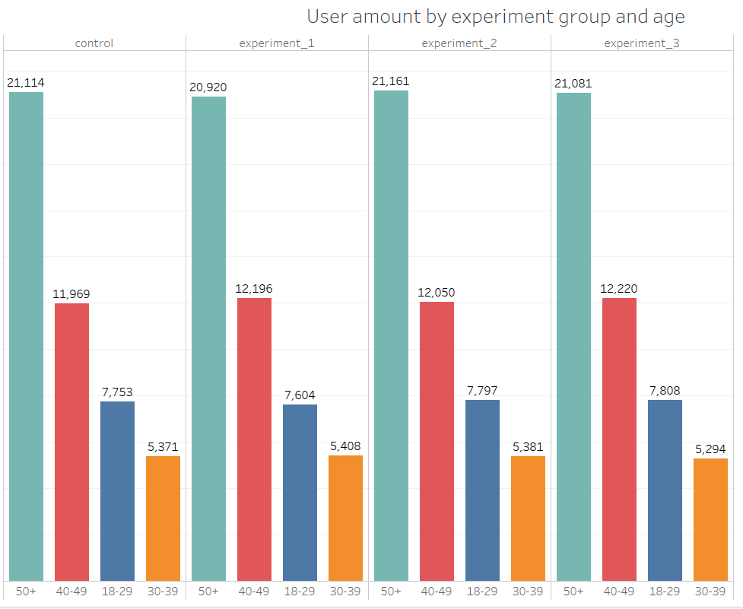
User Segments
Age
As we can see on the plot below, the group with the largest amount of users is the group with people older than 50 years.

Slide 11
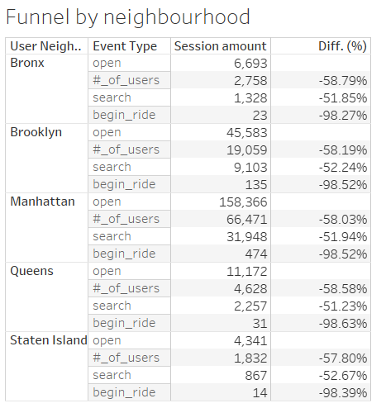
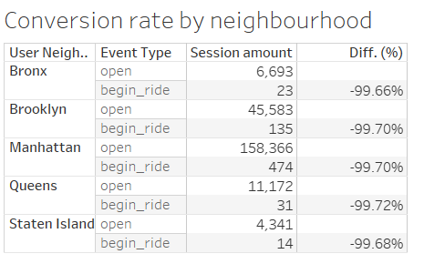
Segment Analysis of Funnel
Identify Opportunities for Improvement
As we can see, the most dramatic drop takes place when moving from “search” to “begin_ride”, so this point would be where we should focus most.
Additionally, the highest conversion rate, from opened sessions to actual rides, takes place in the Bronx, which has the lowest drop (in percentage). On the other hand, the highest drop takes place in Queens, so here we would have an improvement opportunity.

Slide 12
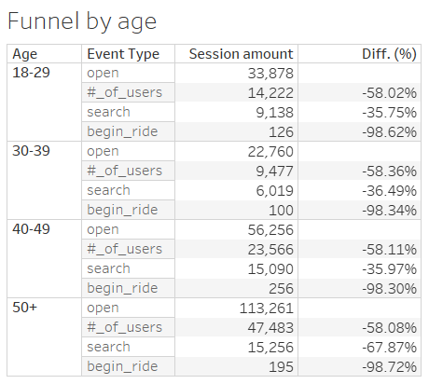
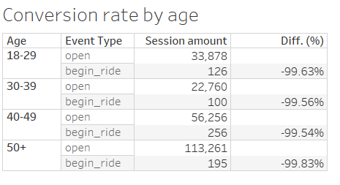
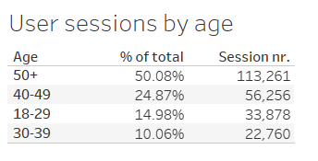
Segment Analysis of Funnel
Identify Opportunities for Improvement
For the “age” segment, we can see that the highest drop takes place for the people who are older than 50 years. This should be one of the most important points to focus on, as this group of people represents more thant the 50% of the sessions registered.
On the other hand, the people between 40-49 years old are who have the highest conversion rate among the registered sessions.

Slide 13
Step 3
Hypothesis & Next Steps

Slide 14
Review Qualitative Data
Read user interviews to understand “why” any funnel under-performance seen in Step 2 might occur.
- It seems that one of the biggest issues is the process to hire the service. Older people have difficulty to hire a flight due to the app usage or the lack of phone service or even to hire it by texting or audio messages. This is why, as we saw in the step 2, the highest drop off in the corversion rate takes place among the customers older than 50 years.
List your hypothesis for what customer need is being under-served.
- The option to book a ride through a phone call.
Provide 3 or more quotes as evidence for this hypothesis
- „ I call up for local pilot, Bob. He‘s not always available but i do not need to fiddle around with an app and hitting tiny buttons“ – Charlie Johnson, 75 y.o.
- „I just hail a taxi or tell my phone to call a cab to go to a certain address (I'm always on the phone, so I just use voice commands with my phone most of the time)” – Kierran Blackburn, 55 y.o.
- “ Luckily, my daughter was around to help me book the ride” – Robbie Gates, 67 y.o.

Slide 15
Suggested Features & Experimentation Plan
We believe that the conversion rate of a 0.17% will increase among the users older than 50 years by including a call/message service to make ride bookings. This increase in the conversion rate will mainly happen among the mentioned users age cohort, which at the same time, will mean a big impact, since this age cohort is the one that most uses Flyber.
Suggested features:
1- Call service for booking.
2- SMS service for booking.
Control group: current system of booking (app).
Experiment group 1: users having the possibility to book just through phone call.
Experiment group 2: users having the possibility to book just through SMS.
Users affected by the experimental changes: users older than 50 years.
Additonal metrics that would be helpful to collect from suggested features:
- Average time between “search” event and making the flight reservation for each group listed above.
- Average ride price.
- Most common time frame in which this features are used.

Slide 16
Appendix
Raw Data

Slide 17
Additional Info
The exploratory analysis that was mainly made in Tableau Public can be found in the following link:
Exploratory analysis – iterative design

